Slide 1
Programming Fundamentals
Chapter 3 - Java Programming Language
Chapter 3

Slide 2
Loop Control

Slide 3
Java - Loop Control
A loop statement allows us to execute a statement or group of statements multiple times. and following is the general form of a loop statement in most of the programming languages −

Slide 4
Java - Loop Control (cont.)
Java programming language provides the following types of loop to handle looping requirements. Click the following links to check their detail.
Java loop control types:
1- While loop
2- For loop
3- Do…while loop

Slide 5
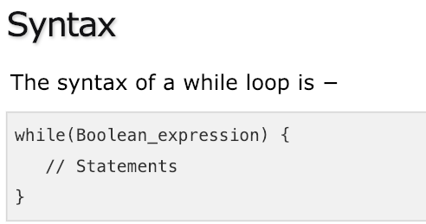
1- While Loop in java
A while loop statement in Java programming language repeatedly executes a target statement as long as a given condition is true.

Slide 6
While Loop in java – Flow Diagram

Slide 7
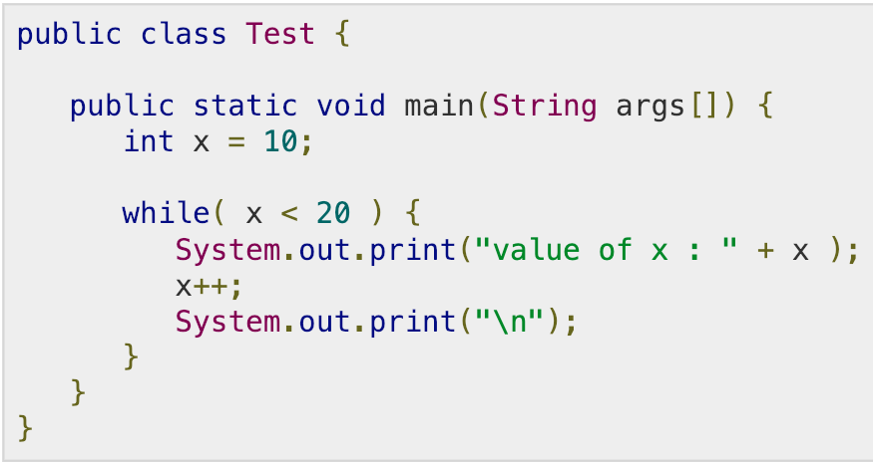
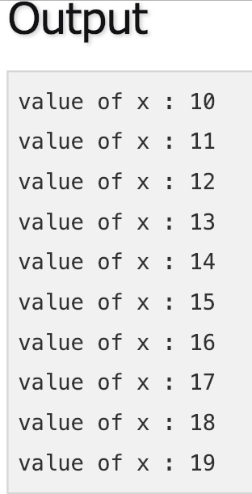
While Loop in java- Example

Slide 8
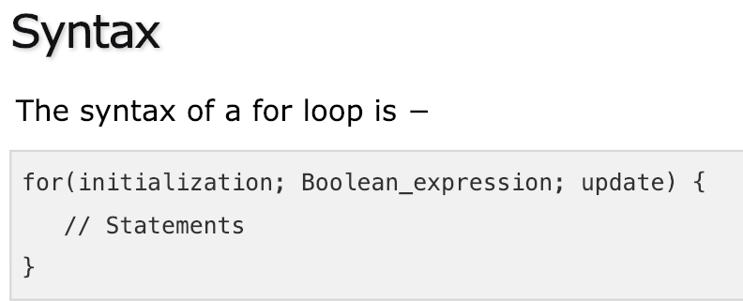
2- For loop in java
A for loop is a repetition control structure that allows you to efficiently write a loop that needs to be executed a specific number of times.

Slide 9
For loop in java- Flow Diagram

Slide 10
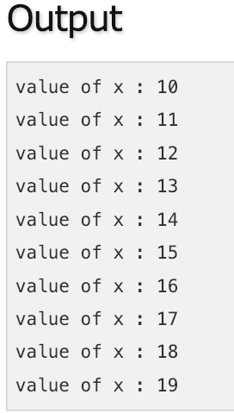
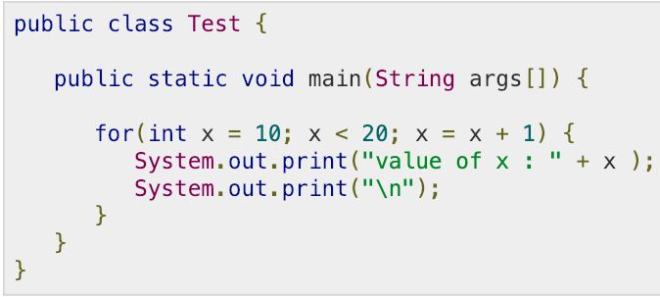
For loop in java- Example

Slide 11
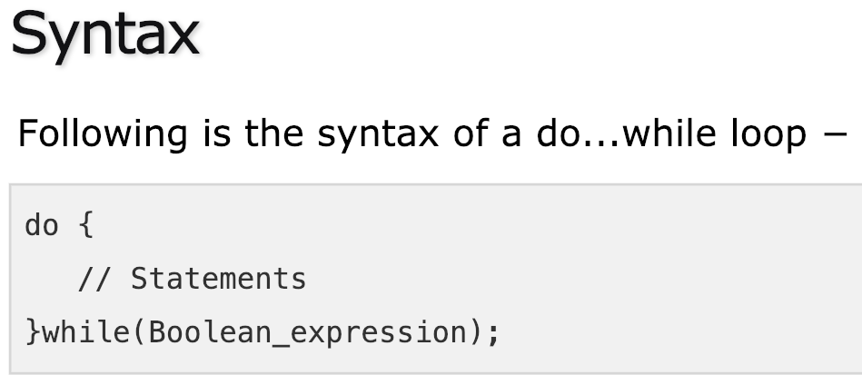
3- Do…while loop in java
A do...while loop is similar to a while loop, except that a do...while loop is guaranteed to execute at least one time.

Slide 12
Do…while loop in java - Flow Diagram

Slide 13
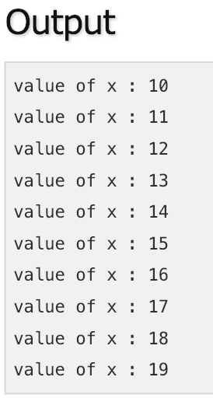
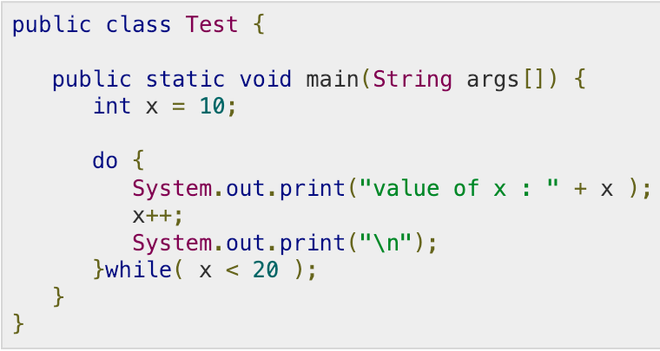
Do…while loop in java - Example

Slide 14
Loop Control Statements

Slide 15
Loop Control Statements
Loop control statements change execution from its normal sequence. When execution leaves a scope, all automatic objects that were created in that scope are destroyed.
loop control statements types:
1- break statement
2- continue statement

Slide 16
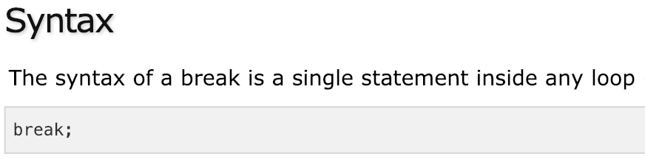
1- Break statement in java
Break statement is encountered inside a loop, the loop is immediately terminated and the program control resumes at the next statement following the loop.

Slide 17
Break statement in java - Flow Diagram

Slide 18
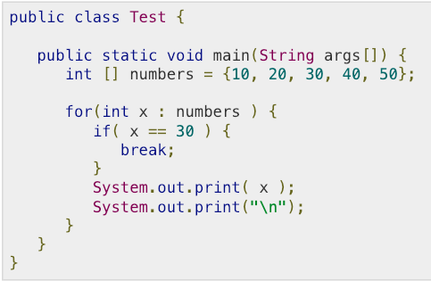
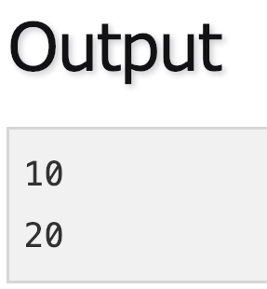
Break statement in java - Example

Slide 19
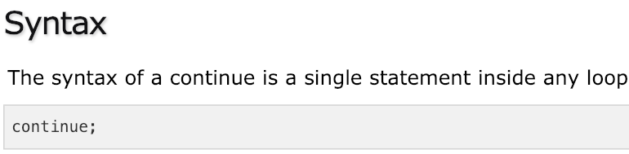
2- Continue statement in java
The continue keyword can be used in any of the loop control structures. It causes the loop to immediately jump to the next iteration of the loop.
In a for loop, the continue keyword causes control to immediately jump to the update statement.
In a while loop or do/while loop, control immediately jumps to the Boolean expression.

Slide 20
Continue statement in java - Flow Diagram

Slide 21
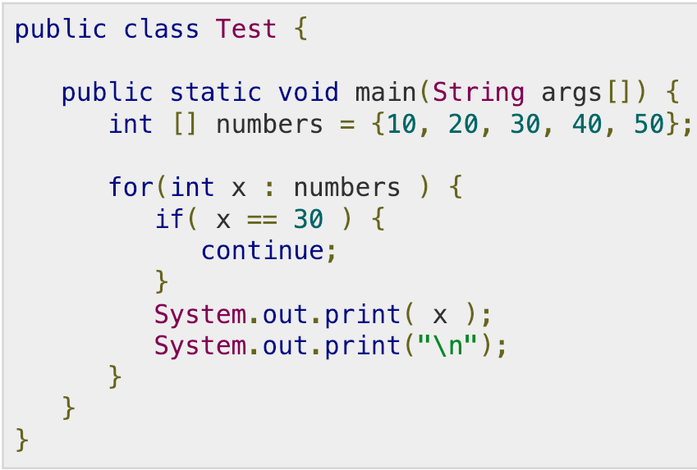
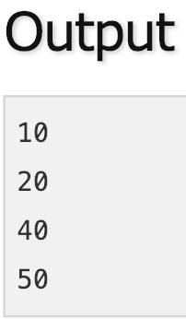
Continue statement in java - Example

Slide 22
Enhanced Loop

Slide 23
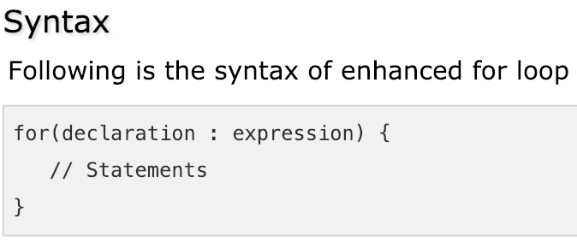
Enhanced for loop in Java
The enhanced for loop was introduced. This is mainly used to traverse collection of elements including arrays.

Slide 24
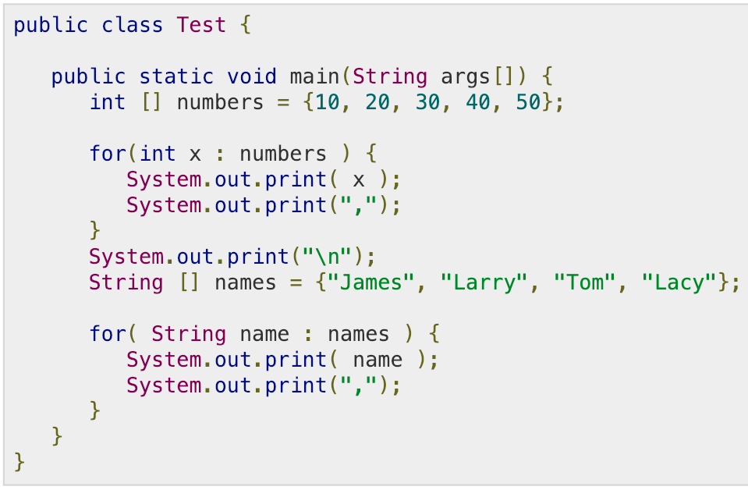
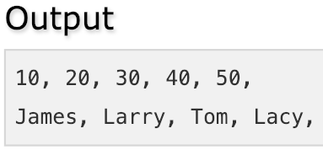
Enhanced for loop in Java - Example

